Slide 1

Slide 1

Slide 2


Connecting the dots: using Data API Builder to expose your SQL Server
Do not record or livestream this session
DANILO DOMINICI
INDEPENDENT CONSULTANT, ITALY
Notes:
In the next sixty minutes we are going to build data APIs over three different databases, understand how security works, and see how to ship one to the cloud in a container — and we will not write a single line of code.
The tool is Data API builder, DAB for short. It is open source, it is free, it comes from the Azure SQL team, and version 2.0 went generally available in June 2026. Everything you see today runs on that version.
I am Danilo Dominici, I am an independent consultant, I work mostly with the Microsoft data platform.
Every data project eventually grows an API: a REST layer over a handful of tables, an authorisation model, a deployment pipeline, and a maintenance burden nobody volunteered for.
Data API builder replaces that layer with a single JSON file — and with version 2.0 it also turns the same configuration into an MCP server for AI agents.
In this session we build APIs over an on-premises SQL Server, an Azure SQL Database and a SQL database in Microsoft Fabric; we secure them with Microsoft Entra ID, roles and item-level policies; and we ship the result as a container running in Azure Container Instances — but we could do the same on AWS.
Four live demos, no application code at all.

Slide 3
What you’ll leave with
01
02
03
A mental model
Where DAB fits between databases and consumers
A working recipe
CLI commands and JSON for SQL Server, PostgreSQL, Azure SQL and Fabric
A deployment path
The same container image in Azure Container Instances and AWS
Assumed knowledge — and what we will not cover
Assumed: T-SQL, basic HTTP/JSON, what a container is. No .NET or GraphQL experience needed.
Not covered: Cosmos DB / MongoDB sources, Static Web Apps database connections, deep GraphQL schema design.
Everything is open source (MIT) and free — there is no premium tier to buy at the end of this talk.
Notes:
Three things.
- A mental model of where DAB fits.
- A working recipe you can copy — the actual commands and JSON are on the slides and in the repository.
- And a deployment path, because a tool you cannot ship is a toy.
I assume you know T-SQL and roughly how HTTP works. I do not assume .NET, and I do not assume GraphQL — if you have never written a GraphQL query, you will still follow everything today.
One thing I am not covering: Cosmos DB and MongoDB sources.
DAB supports them, but they are out of the scope of this session.

Slide 4
1 - WHY
The part of every data project nobody wants to own
Why Data API builder exists
Notes:
Let us start with the problem, because DAB only makes sense if you recognise the problem first.

Slide 5
The CRUD API tax is plumbing you keep rewriting
Boilerplate — controllers, DTOs, mappers, validation, pagination, sorting, filtering. Per table. Again.
Security glue — token validation, role checks, column masking, row filters reimplemented per service.
Drift — the database changes on Monday; the API contract catches up next sprint.
Operations — logging, tracing, health probes, caching, and CI/CD for code that only moves rows.
DAB’s bet: the plumbing is a solved problem and should be configuration, not code.
Notes:
Think about the last data API you shipped. Four categories of work.
Boilerplate. A controller, a DTO, a mapper, validation, pagination, sorting, filtering. Per table. And when a table is added, all of it again.
Security glue. Token validation, role checks, hiding a salary column from one consumer, filtering rows by tenant. Reimplemented in every service, subtly differently, which is exactly how audit findings are born.
Drift. The database changes on Monday. The API itself must be adapted and redeployed, or the consumer discovers the mismatch in production.
Operations. Logging, tracing, health probes, caching, and a build pipeline — for code whose entire purpose is to move rows from a table to a JSON document.
So the uncomfortable question: of that last API, what percentage of the code was actual business logic?
(pause — let someone answer)
Every time I ask, the answer is somewhere between ten and twenty percent. Everything else is plumbing. DAB's bet is simple: the plumbing is a solved problem, and it should be configuration, not code.

Slide 6
What DAB actually is
An open-source, configuration-driven engine that serves REST, GraphQL and MCP over existing database objects.
Stateless process: run it as a container, a sidecar, or a local CLI.
Not a code generator: there is no scaffolded project to maintain.
1 JSON config
0 lines of API code
3 endpoint types
MIT open source
One entity model, one permission model, three surfaces: REST for integrations, GraphQL for front ends, MCP for agents.
Notes:
DAB is an open-source engine, configuration-driven, that reads a JSON file and serves REST, GraphQL and MCP endpoints over database objects that already exist.
Two things it is not.
It is not a code generator — there is no scaffolded project sitting in your repository rotting.
And it is not a schema browser: nothing is exposed unless you list it.
One configuration file. Zero lines of API code. Three endpoint surfaces. MIT licence, no premium tier, no per-call pricing — so let me kill the question early: there is nothing to buy at the end of this talk.
The detail people underestimate is the third card: REST for the integration team, GraphQL for the front-end team, MCP for the AI agents — all generated from the same entities, with the same permissions and the same policies. One place to get security right instead of three.

Slide 7
Architecture
REST client
SQL Server (on-prem / VM)
Data API builder
/api
stateless container
Entity abstraction layer
Azure SQL DB & MI
GraphQL client
/graphql
RBAC + item-level policies
SQL database in Fabric
Query builder (deterministic T-SQL)
AI agent (MCP)
/mcp
Cache L1 / L2 · OpenTelemetry
PostgreSQL · MySQL · Cosmos DB
Notes:
Left to right. Consumers on the left, speaking HTTP to three paths: /api, /graphql, /mcp.
The engine in the middle is a stateless container. Inside it, four things matter today.
The entity abstraction layer is the important one: consumers see the entities you published, never the schema. You choose the names, you choose the columns.
Then RBAC and item-level policies — who can do what, and which rows they see. Then the query builder, which turns a request into parameterised T-SQL deterministically. And finally caching and telemetry, which you would otherwise have built yourself.
On the right, the data sources. Note that it is sources, plural — one instance can hold several at once, and in demo 3 we will do exactly that.
Because the engine is stateless, scaling out is just more replicas. There is no session state to worry about, no sticky routing.

Slide 8
Run the same engine anywhere containers run
Sources:
  SQL Server 2016+
  Azure SQL DB/MI
  Fabric SQL
  Synapse dedicated SQL
  PostgreSQL 11+
  MySQL 8+
  Cosmos DB for NoSQL.
Deployment:
  Azure: Container Instances, Container Apps, AKS, App Service.
  AWS / GCP / OCI: ECS/Fargate, EKS, App Runner, Cloud Run.
  On-premises: Docker, Kubernetes, or the bare CLI.
  Locally: dab start.
Feature availability differs by source. The SQL family has the richest GraphQL aggregation, stored procedure, caching and MCP support.
Notes:
Supported sources with their minimum versions: SQL Server 2016 and later, Azure SQL and Managed Instance, SQL database in Fabric, Synapse dedicated pools, PostgreSQL 11, MySQL 8, and Cosmos DB for NoSQL.
Where it runs: anywhere with container support. That is genuinely the whole rule. Azure, AWS, GCP, Oracle Cloud, or your own data centre.
Two honest caveats. The minimum versions are real — if you have SQL Server 2014 somewhere, that instance is out. And the feature matrix is not uniform: aggregation, stored procedures, caching and MCP are richest on the SQL family. Check the matrix before you promise something on MySQL.

Slide 9
2 - CONFIG
One file, six commands, three surfaces
Anatomy of a configuration
Notes:
Now the file. This is the part people screenshot, so I will go slowly.

Slide 10
dab-config.json is the contract
<
Runtime controls surfaces, cache, CORS and authentication.
Entities alias tables, views and stored procedures
Permissions decide what each role can do
"data-source": {
"database-type": "mssql",
"connection-string": "@env('SQL_CONN')"
},
"runtime": {
"rest": { "enabled": true },
"graphql": { "enabled": true },
"mcp": { "enabled": true }
},
"entities": {
"Policy": {
"source": {
"object": "dbo.Policies", "type": "table"
},
"rest": { "path": "policies" }
}
}
10
Notes:
Three sections. That is the whole mental model.
data-source: what kind of database and how to reach it. Notice the connection string is not a literal — @env() pulls it from an environment variable, and @akv() pulls it from Azure Key Vault. Nobody puts a password in this file.
runtime: how the engine behaves. Which surfaces are on and at which paths. Cache. CORS. Host mode. Authentication provider.
entities: what you publish. Here, one entity called Policymapped to dbo.Policies, exposed at /api/policies, readable by anonymous users.
The one setting to remember from this slide is host.mode. In development you get Swagger, the GraphQL playground and verbose errors. In production those disappear. Forgetting to switch it is the single most common mistake I see.

Slide 11
Six commands cover 95% of the work
The CLI writes schema-valid JSON, is scriptable, and belongs in CI.
New in 2.0: dab auto-config, auto-config-simulate, --show-effective-permissions, --mcp-stdio.
dab init --database-type mssql --connection-string "@env('SQL_CONN')"
dab add Policy --source dbo.Policies --permissions "reader:read"
dab update Policy --permissions "writer:*"
dab configure --runtime.cache.enabled true
dab validate
dab start
11
Notes:
You normally don’t hand-write that file, because the CLI writes it for you and it writes schema-valid JSON.
dab init scaffolds. dab add publishes an object — repeat per entity. dab update and dab configurechange things afterwards. dab validate checks the file. dab start runs the engine.
The one I want in your pipeline is dab validate. It is the cheapest guard rail you will ever add: a malformed config fails your build instead of your deployment.
Four of these are new or extended in 2.0 — auto-config, the simulation command, effective permissions, and MCP over stdio. We will see all four.

Slide 12
Entities, roles and policies
SECURITY MODEL
Publish tables, views and stored procedures — nothing else is reachable.
Rename objects and columns; hide fields per role with include / exclude.
Descriptions become semantic hints agents read over MCP.
Role-based authorization controls create / read / update / delete / execute.
Item-level policies inject an OData-style predicate into the WHERE clause.
Claims flow into SQL session context, so database RLS still works.
Notes:
Two things earn DAB its place in a security review.
First, the abstraction layer. Only tables, views and stored procedures you listed are reachable. You can rename the object, rename the columns, and hide columns per role with include and exclude lists. And you can attach a description — which, as we will see, is what an AI agent reads to understand your data.
Second, two layers of authorisation. Role-based: which actions a role may perform. And item-level policies: an OData-style predicate, here saying a broker only sees their own rows.
This matters — the policy is pushed into the generated query. It is a predicate in the WHERE clause, not a filter applied to rows already fetched. And the claims from the token are pushed into SQL's session context, which means your existing row-level security keeps working unchanged.

Slide 13
REST
REST
GET /api/Policy — paged collection
GET /api/Policy/id/42 — single item
POST /api/Policy — insert
PATCH / PUT /api/Policy/id/42 — update / upsert
DELETE /api/Policy/id/42 — delete
GET /api/openapi — OpenAPI document + Swagger UI
$select · $filter · $orderby · $first · $after — OData-like syntax translated into parameterised queries, not string concatenation.
Notes:
The REST surface, for free. Collection, single item by key, insert, update, upsert, delete. Plus an OpenAPI document and Swagger UI.
Query operators are OData-like: $select, $filter, $orderby, $first, $after for pagination.
The point to say out loud, because someone in this room is already worried: filters are translated into parameterised queries. This is not string concatenation.

Slide 14
Relationships and aggregations without N+1
GRAPHQL
Relationships are declared in config; nested reads become a single query.
sum, avg, min, max and count with groupBy are available on the SQL family.
query {
policies(filter: { status: { eq: "active" } })
{ items { id product premium broker { name city } } }
}
Notes:
Same data, different shape. Two things worth your attention even if you never write GraphQL.
Relationships: declared in the configuration. They can mirror a foreign key, or you can invent one that does not exist in the database. A nested read becomes one query, not N+1.
Aggregation: sum, average, min, max, count, with groupBy. SQL family only. It means a simple dashboard does not need a separate service in front of the database.
Enough theory. Let us build one.

Slide 15
Demo 1: SQL Server on-premises — zero to API
LIVE DEMO
RUN SHEET
POINT TO MAKE
docker run SQL Server 2022 with a small insurance schema.
Under five minutes from empty folder to working REST + GraphQL API.
The database was already there: nothing migrated, nothing generated.
dab init → dab add Policy / Broker / vw_PolicySummary / sp_RenewPolicy.
dab start

Slide 16
3 – WHAT’S NEW
GA since June 2026 — agents and automation
What’s new in 2.0
Notes:
Version 2.0 went GA in June 2026. If you used DAB a year ago, this is the section you came for.

Slide 17
Nine things that changed in version 2.0
RELEASE 2.0
Auto configuration · pattern-based entities re-evaluated at every start
On-Behalf-Of auth · the database sees the real end user
Custom MCP tools · stored procedures become named agent tools
Unauthenticated provider · simpler development default
Role inheritance · named-role → authenticated → anonymous
Advanced REST paths · slashes allowed in paths
Permission-aware OpenAPI · a role sees only what it can call
OpenTelemetry by default · traces for REST, GraphQL and MCP
Response compression · optimal / fastest / none
Notes:
I am not going to read nine cards. Three themes.
AI integration — MCP tools, custom tools, traced tool calls.Simpler defaults — a new authentication provider, role inheritance, OpenTelemetry pre-wired. Less configuration by hand — auto-config, and better tooling to understand what your config actually does.
Four of them deserve real time.

Slide 18
Stop hand-writing entity blocks for large schemas
A 300-table schema stops being a 5,000-line config.
Patterns are re-evaluated at every start; new matches appear automatically.
Tables only, Microsoft SQL only, in 2.0. Views and stored procedures still need dab add.
dab auto-config my-def
--patterns.include "dbo.%"
--patterns.exclude "dbo.internal%"
--patterns.name "{schema}_{object}"
dab auto-config-simulate # preview before you
Notes:
Here is the problem it solves. A schema with three hundred tables produces a configuration file with three hundred entity blocks, and every new table means a pull request.
With dab auto-config you define patterns instead: include dbo.%, exclude dbo.internal%, name them by a template, apply a permission set and a cache template. The patterns are re-evaluated at every start, so a new matching table appears automatically.
And before you commit anything, dab auto-config-simulate connects to the database and prints exactly which objects match. Put that in your pipeline.
Now the objection I always get: "so it leaks my schema." No — you write the patterns and you write the exclusions, and the abstraction layer still applies. But be aware of the 2.0 limits: tables only, Microsoft SQL sources only. Views and stored procedures still need dab add.

Slide 19
Role inheritance makes effective permissions inspectable
named-role inherits from authenticated; authenticated inherits from anonymous.
Define read once on anonymous and broader roles inherit it. Configure a role explicitly and inheritance stops there.
dab configure --show-effective-permissions turns hidden reasoning into reviewable output.
Entity: Book
Role: anonymous | Actions: Read
Role: authenticated | Actions: Read (inherited from: anonymous)
Unconfigured roles inherit from: anonymous
Entity: Order
Role: admin | Actions: Create, Read, Update, Delete
Role: anonymous | Actions: Read
Role: authenticated | Actions: Read (inherited from: anonymous)
Notes:
New in 2.0: roles inherit. A named role falls back to authenticated, and authenticated falls back to anonymous.
The upside: define read once on anonymous and everyone gets it. The risk, and I want you to hear it clearly: a permission you left on anonymous during testing now reaches every role in the system.
Which is why the second half of this slide exists. dab configure --show-effective-permissionsprints the resolved permissions for every entity and every role, including what was inherited and from where.
My recommendation: generate that output in your pipeline and diff it between releases. A permissions change that nobody intended shows up as a diff instead of as an incident.

Slide 20
The Unauthenticated provider
Unauthenticated — every request is anonymous. Good for demos or internal read-only APIs behind a gateway.
EntraId — validates Microsoft Entra tokens; roles come from claims.
Custom JWT — any issuer, audience, issuer and signing key in config.
AppService EasyAuth — trusts the platform-injected identity header.
Simulator — fakes a role in development host mode only.
Important: with Unauthenticated, authenticated and custom roles never activate — even if something in front of DAB authenticated the caller.
Notes:
2.0 introduces a new authentication provider called Unauthenticated, and makes it the default for new configurations. Every request runs as anonymous; no JWT is inspected at all.
The intent is good — dab init now produces something that just runs, without configuring an identity provider first.
The trap: when this provider is active, authenticated and every custom role are never activated. Even if a gateway in front of DAB authenticated the caller. If you re-scaffold a config with 2.0 and your carefully written role permissions suddenly do nothing, this is why. DAB does warn at startup — but nobody reads startup logs until something is broken.
The other providers are unchanged: Entra ID, a custom JWT issuer, App Service EasyAuth, and the simulator for local testing.

Slide 21
On-Behalf-Of
USER
→
DAB · OBO
→
AZURE SQL
→
RLS / AUDIT
User signs in and gets a JWT. DAB exchanges the token. Azure SQL authenticates as the end user. RLS and audit trails see a person.
Needs mssql, user-delegated-auth, EntraId, database-audience, app registration and SQL Entra acceptance.
Trade-off: cache disabled, one connection pool per user, token-exchange latency.
Notes:
This one is my favourite feature in 2.0.
Normally DAB connects to the database as itself — one identity, one connection pool. Which means row-level security and audit logs see a service account, not a person.
With On-Behalf-Of, DAB takes the caller's token and exchanges it for a database token. The database then authenticates as the actual end user. Row-level security and auditing finally see a person.
What it needs: mssql only, Entra ID, an app registration, three environment variables, and a SQL instance configured to accept Entra tokens.
What it costs, and I want to be balanced here: caching must be disabled — results are per-user by definition. You get one connection pool per user, so you lose most of the pooling benefit. And a token exchange sits on the request path.
So: not something you turn on everywhere. But when compliance asks "who read this row?" — or when an agent is acting and the honest answer to "who is acting" is otherwise "the service" — this is the feature that answers.

Slide 22
SQL MCP Server
describe_entities · read_records · create_record · update_record · delete_record · execute_entity · aggregate_records
DAB builds deterministic T-SQL through the same entity layer, RBAC and policies as REST and GraphQL.
New in 2.0: stored procedures can be registered as named custom tools.
Transports: streamable HTTP at /mcp or local stdio.
Why not NL2SQL? Models are non-deterministic; typed tools keep permissions, caching and traces in the same control plane.
Notes:
Since version 1.7, every DAB instance is also an MCP server. In 2.0 it got custom tools and full tracing.
Seven built-in tools: describe entities, read, create, update, delete, execute a stored procedure, aggregate. An agent calls those tools; DAB builds the T-SQL. Every call goes through the same entity layer, the same RBAC and the same policies as REST.
New in 2.0: set custom-tool on a stored-procedure entity and it becomes a named tool the agent can discover and call by name. Your existing business logic, exposed to an agent, with no glue code.
And the design decision that makes this enterprise-viable: DAB deliberately does not do NL2SQL. The model never generates SQL. Models are non-deterministic, and the complex queries people most want AI to write are exactly the ones where a subtle error is hardest to spot. Instead you get a fixed set of typed tools over the entities you chose.
If you have been asked "can we let Copilot query the warehouse" and you have been saying no — this is the shape of a yes.

Slide 23
REST and OpenAPI
Advanced REST paths — /api/shopping-cart/item and /api/invoice/item can coexist.
Permission-aware OpenAPI — /openapi/{role} shows only reachable methods and fields.
Keyless PUT / PATCH — upsert when the database generates omitted keys.
Response compression — optimal, fastest, none.
Notes:
Four smaller changes, twenty seconds each.
Entity paths may now contain slashes, so you can group endpoints under a prefix without contrived entity names.
The OpenAPI document is permission-aware: it shows only the methods and fields a role can reach, and /openapi/{role}renders one role's view — development mode only, so nobody enumerates your roles in production.
Keyless PUT and PATCH: upsert without inventing a key when the database generates it.
And response compression, one setting.
The one worth dwelling on is permission-aware OpenAPI. Your API document stops being a map of everything you own and becomes a contract per consumer.

Slide 24
Observability is wired before the first deploy
Sinks: OTLP for Grafana / Jaeger, Application Insights, Log Analytics, structured file logs.
/health returns status, version and app name; per-source and per-entity checks can add response-time thresholds.
MCP tool calls share trace IDs with REST and GraphQL.
"telemetry": {
"open-telemetry": {
"enabled": true,
"endpoint": "@env('OTEL_EXPORTER_OTLP_ENDPOINT')"
}
}
Notes:
For a DBA audience this is not a footnote. The first objection to any new middle tier is "I will not be able to see what it is doing to my database."
dab init in 2.0 generates a telemetry section pre-wired to the standard OpenTelemetry environment variables. Set them and traces flow — to Grafana, Jaeger, Application Insights, whatever speaks OTLP. If the variables are absent, DAB starts normally and skips the exporter.
New in 2.0: MCP tool calls are traced alongside REST and GraphQL, with the same trace IDs. One dashboard covers human traffic and agent traffic — which, when the auditors arrive, is the first thing they ask for.
There is also a health endpoint with per-data-source and per-entity checks and response-time thresholds. And a small detail I appreciate: DAB puts dab-<version> in the connection string's application name, so you can find its sessions in the DMVs.

Slide 25

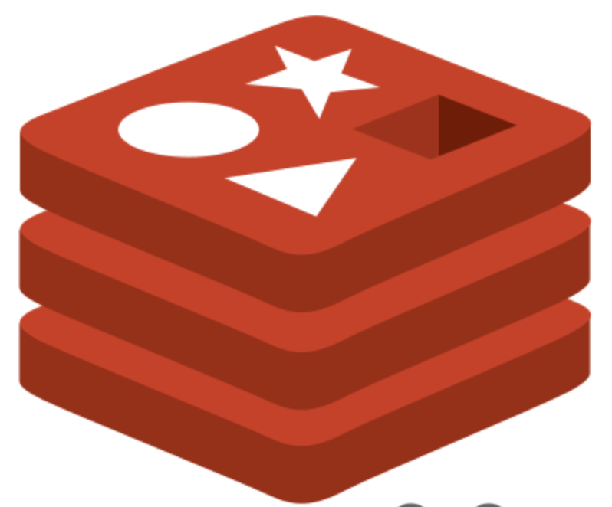
Caching scales reads without hiding user context
REQUEST
→
L1 MEMORY
→
L2 REDIS
→
DATABASE
Request → L1 in-memory → L2 Redis → database. Misses write the result back to both layers.
L2 provides shared cache across replicas, warm restarts and environment partitions.
Caching applies to REST reads, invalidates on write through DAB, and is opt-in per entity.
OBO and caching do not mix: per-user results must not be shared.
Notes:
Two levels. L1 is in-process memory. L2 is a distributed cache — Redis today — shared across instances.
With L1L2, a lookup checks L1, then L2, then the database, and the result is written back into both. Two consequences that matter: a second instance can serve from L2 and promote into its own L1, and a recycled container starts warm instead of cold.
Caching is enabled globally and opted into per entity. Partitions let several environments share one Redis.
Two warnings. DAB invalidates the cache on writes that go through DAB — a write straight into the table from SSMS invalidates nothing, so keep your TTLs honest. And cache and On-Behalf-Of are mutually exclusive.

Slide 26
Demo 2: Azure SQL
LIVE DEMO
RUN SHEET
POINT TO MAKE
Point the same config at Azure SQL;
Same JSON, different data source. The policy lands inside generated T-SQL; claims reach SESSION_CONTEXT.

Slide 27
4 – HYBRID
One API, several databases
Multi-source configs and Microsoft Fabric
Notes:
This is the part that gets the loudest reaction from anyone who maintains linked servers.

Slide 28
Multi-source configuration
No cross-source joins: composition happens in the client/agent.
Useful when linked servers are not viable, data spans clouds/tenants, or consumers need one contract.
No cross-source joins: composition happens in the client/agent.
"data-source-files": [
"dab-config.onprem.json",
"dab-config.azuresql.json",
"dab-config.fabric.json"
]
Top-level runtime enables REST, GraphQL and MCP for all child files.
Every child needs data-source + entities; names and paths must be unique.
Notes:
One DAB instance, several databases. You write a top-level file that lists child configuration files, and each child brings its own data source and its own entities.
Rules. Every child needs both a data-source and an entities section. Only the top-level runtime is honoured — put runtime settings in a child and they are ignored. And entity names, GraphQL type names and REST paths must be unique across all files. A collision fails at startup, loudly, which is exactly what you want.
Where this replaces a linked server: policy forbids linked servers; one of the systems is not SQL; the data lives in another cloud or another tenant; or you simply want one contract instead of three integrations.
The limitation, stated plainly: DAB does not join across sources. You get one endpoint, one auth model, one OpenAPI document — the composition happens in the client, or in the agent. That is still a very large win, but it is not a distributed query engine.

Slide 29
Microsoft Fabric
SQL database in Fabric → mssql → Entra authentication only; no SQL logins.
Fabric Warehouse / Lakehouse SQL endpoint / Synapse dedicated pool → dwsql.
Lakehouse SQL endpoint is read-only by nature: expect reads and aggregations, not writes.
Use a managed identity or service principal; the local SQL-auth container flow will not work here.
Notes:
Fabric deserves its own slide because the details trip people up.
A SQL database in Fabric is mssql — the same database type as anything else in the SQL family. The catch: it accepts Microsoft Entra authentication only. No SQL logins. So you use a managed identity or a service principal, and the local-container flow in the VS Code extension, which needs SQL auth, will not work against it.
The Fabric Warehouse and Lakehouse SQL endpoints are dwsql. Two practical notes: drop the tcp: prefix from the server name — it is rejected — and use Authentication=Active Directory Default.
Synapse dedicated pools are also dwsql, with the narrower feature set that implies.
And a detail that helps when someone asks whether this is a toy: DAB is itself a component of Microsoft Fabric. The engine you run in your own container is the same engine that powers Fabric's own data APIs.

Slide 30
Demo 3: Fabric + multi-source hybrid API
LIVE DEMO
RUN SHEET
POINT TO MAKE
Three child configs: on-prem SQL Server, Azure SQL, Fabric SQL database.
Three databases, one OpenAPI document. A friendly startup failure beats a production 500.
One top-level file with data-source-files and one runtime block.
dab validate → dab start → /api/Policy, /api/Broker, /api/SalesFact.
/health reports named sources, status and timing. Trigger a deliberate name collision.

Slide 31
5 – MCP
Call DAB from your favorite agent

Slide 32
Demo 4: querying database using natural language
LIVE DEMO
RUN SHEET
POINT TO MAKE
Demo app (React/Typescript) that calls MCP exposed by DAB.
Three databases, one OpenAPI document. A friendly startup failure beats a production 500.
dab validate → dab start → /api/PolicySummary.

Slide 33
6 – SHIP IT
The same container image, in Azure and on AWS

Slide 34
Pick your host
Azure Container Instances — fastest path for demos, internal APIs and pilots.
Azure Container Apps — scale to zero, revisions, managed identity.
AKS — full control when you already run Kubernetes.
App Service — container or code with EasyAuth integration.
AWS ECS / Fargate and App Runner — same public image, different task/secret wiring.
Docker / Kubernetes on-prem — same image and config, no cloud required.
Notes:
One public image, mcr.microsoft.com/azure-databases/data-api-builder. It listens on port 5000. It is stateless. Whatever runs containers in your organisation already runs DAB.
Container Instances is the fastest path — one container, a public IP or a VNet, no orchestrator. That is what I will demo.
Container Apps is where most production APIs belong: scale to zero, revisions, managed identity built in. AKS if you already run AKS. App Service if that is your estate. On AWS: ECS on Fargate, or App Runner. And on-premises Docker or Kubernetes if the data cannot leave the building.

Slide 35
The ACI recipe
Keep the secret outside the image. Prefer managed identity or @akv() from Key Vault.
FROM mcr.microsoft.com/azure-databases/data-api-builder:latest
COPY dab-config.json /App/dab-config.json
az acr build --registry $ACR --image dab:1 .
az container create ... --ports 5000 --environment-variables "DATABASE_CONNECTION_STRING=$CONN"
curl http://<fqdn>:5000/health → { "status": "healthy", "version": "2.0.x" }
Notes:
Three steps.
One: build the configuration with the connection string as an environment variable reference, so the secret never enters the file.
Two: build an image whose only addition to the base image is your config, copied to /App/dab-config.json. az acr build does the build in Azure — no local Docker needed.
Three: az container create with the image, port 5000, a DNS label, and the connection string as an environment variable.
Then check /health, and open /api/openapi from the public name.
Two of the things on that slide are demo shortcuts and I want to name them: the admin-enabled registry, and the connection string as a plain environment variable. In production, use a managed identity for the database, pull secrets with @akv()from Key Vault, put the container in a VNet behind a gateway, and switch host mode to production.
The docs also describe mounting the config from an Azure Files share instead of baking it into the image. Both work. I prefer the image because it versions with your pipeline: one immutable artefact, one tag, one rollback.

Slide 36
The same image on AWS
ECS / Fargate: mirror the image into ECR, expose port 5000, health-check /health, inject Secrets Manager values.
App Runner: point at the image for automatic HTTPS and scaling.
Identity changes: AWS has no managed identity for Azure SQL; use SQL login or service principal from Secrets Manager.
Networking and egress cost become explicit design decisions.
Everything else — config, entities, permissions, endpoints — is byte-for-byte identical.
Notes:
Same image, no modification. On ECS with Fargate: a task definition with container port 5000, an ALB target group, a health check on /health, and the connection string from Secrets Manager. Scale on CPU or request count, because the process is stateless. App Runner is even simpler — point it at the image and you get HTTPS and scaling with no load balancer to configure.
Now the honest part. DAB is genuinely portable; the identity story is not. From AWS you have no managed identity for Azure SQL, so you are back to a SQL login or a service principal with a client secret. Private connectivity between an AWS VPC and Azure SQL means firewall rules, Private Link or a VPN. And an API in one region reading a database in another is a design decision with a latency and egress bill attached — decide it deliberately.
Everything else — configuration, entities, permissions, endpoints — is byte-for-byte identical.

Slide 37
Demo 5: deploy to Azure Container Instances
LIVE DEMO
RUN SHEET
POINT TO MAKE
Build with az acr build; keep the connection string outside the image.
From a JSON file to a public API in roughly three minutes. Production host mode is the most forgotten switch.
az container create → curl /health → open /api/openapi.
Flip host mode to production and show Swagger disappear.
Point an MCP client at /mcp; walk through the same ECS task definition.

Slide 38
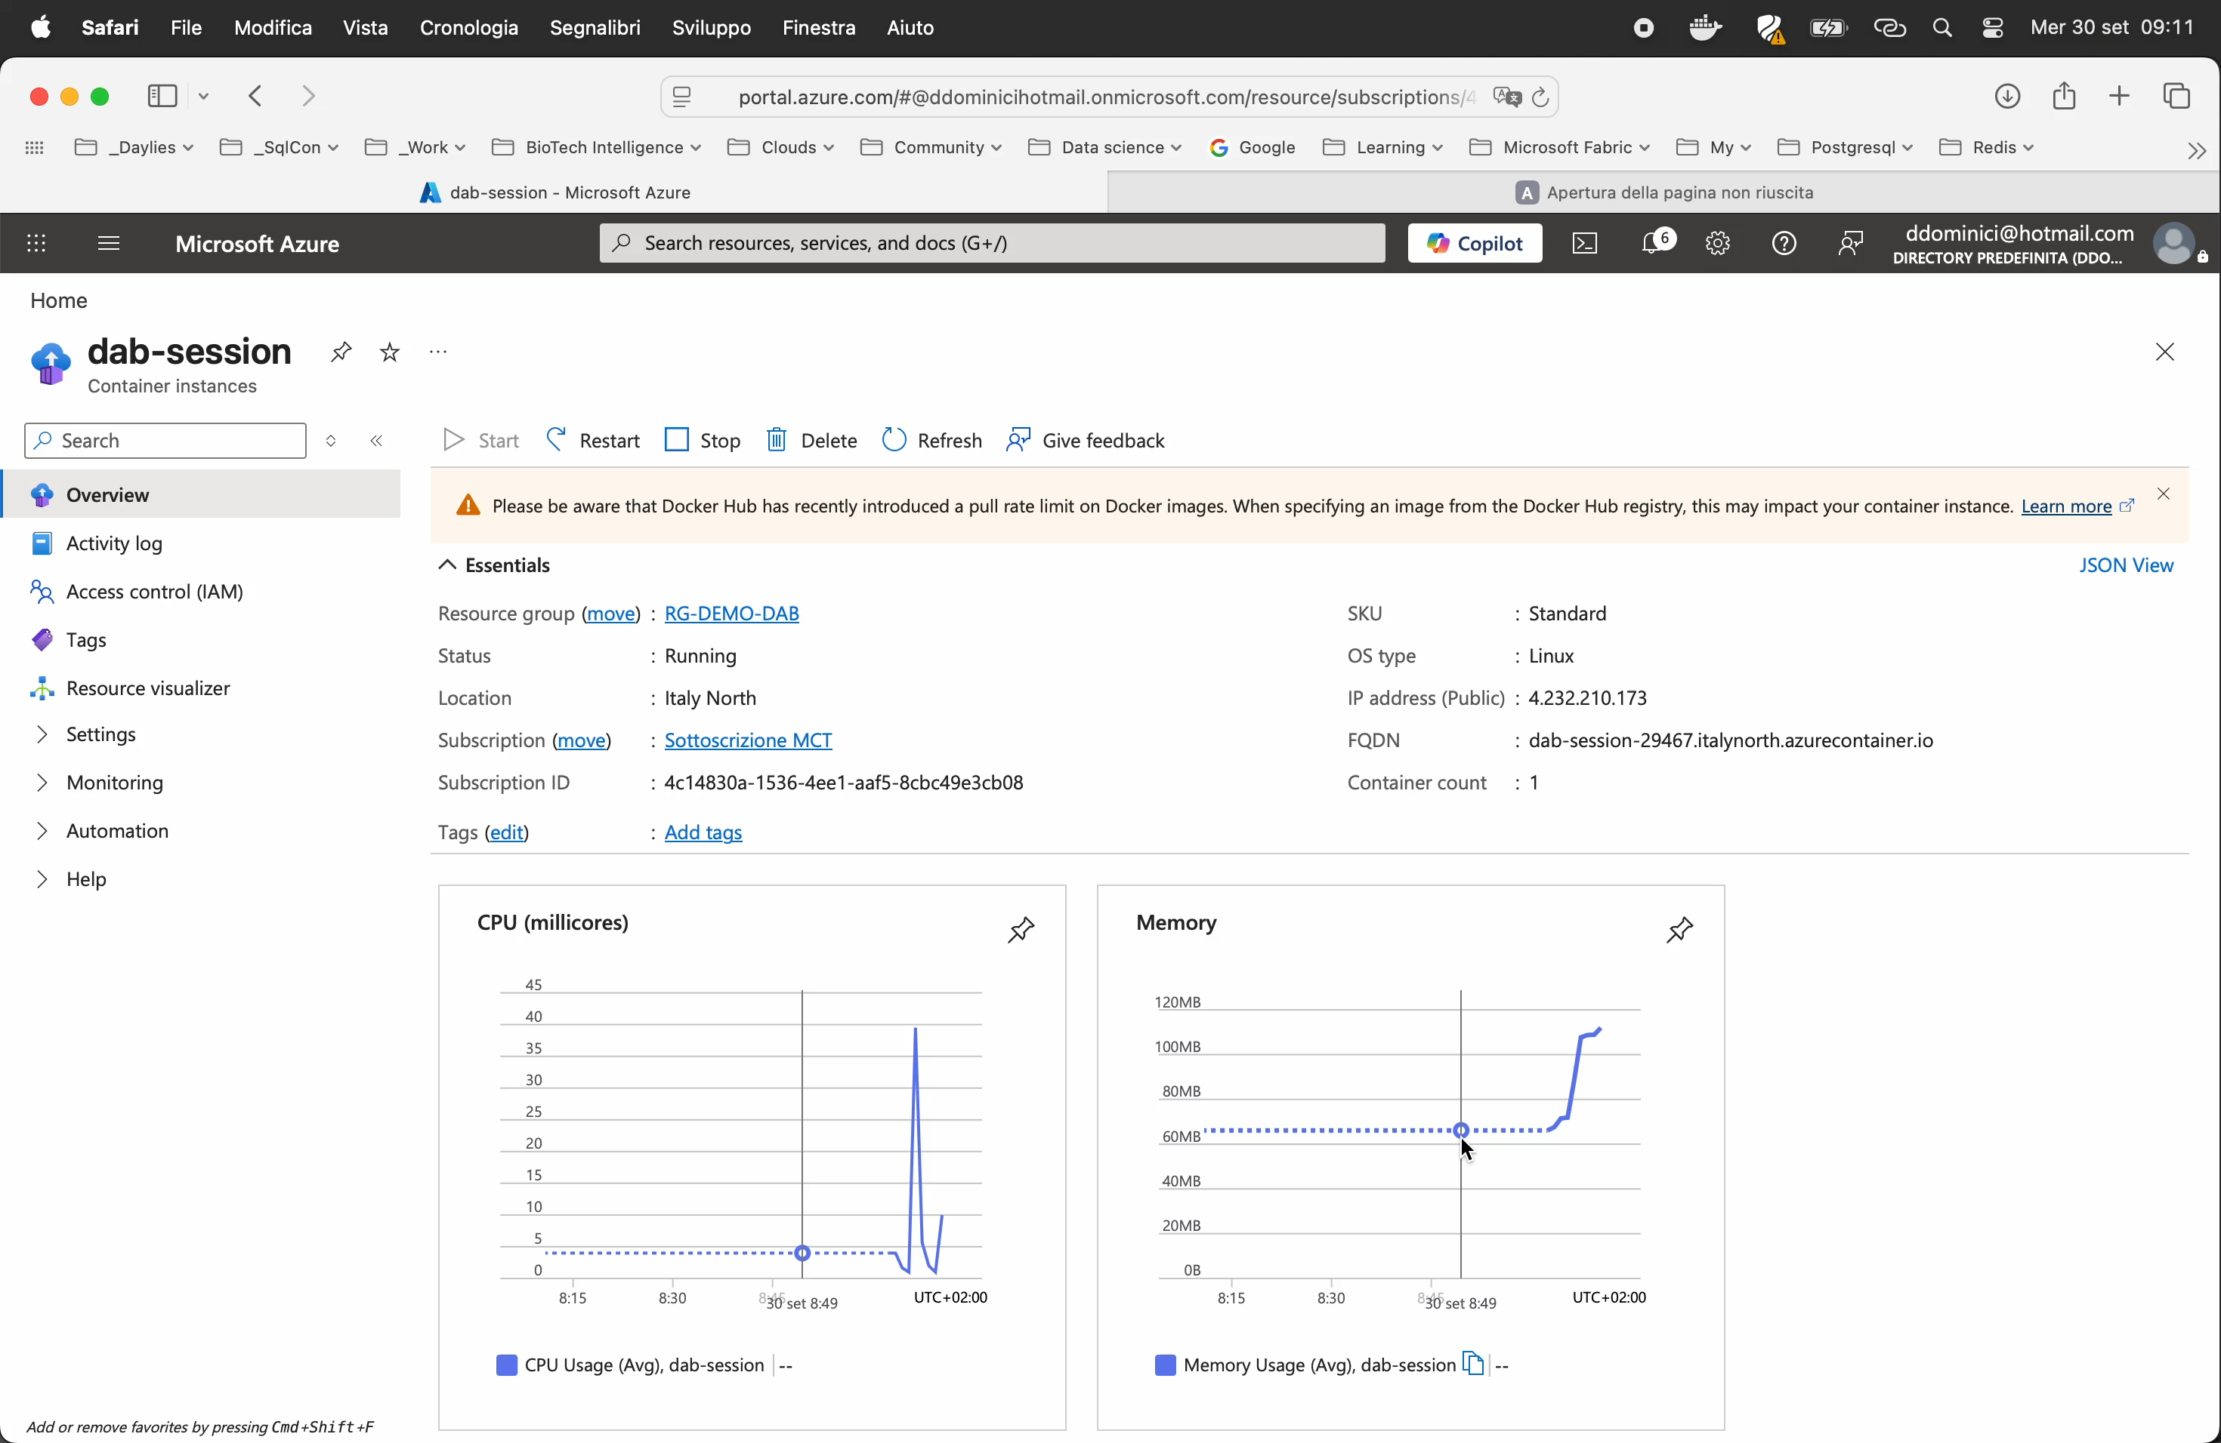

Slide 39
The production checklist is short — if you are honest
host.mode=production · real auth provider · explicit CORS · @env/@akv secrets · review effective permissions
SECURITY
DATA
least-privilege database user · item policies or RLS · publish only intended columns · cache TTLs match writes
/health on platform probe · OTel traces flowing · dab validate in pipeline · pin image tag · load-test realistic filters
OPERATIONS

Slide 40
When DAB is the wrong answer
Not a fit when the API is a workflow, not data access.
Not a fit when you need cross-source joins in one call.
Not a fit when you need DDL from the API; MCP is deliberately DML only.
Not a fit when the consumer contract cannot be expressed by your query model.
Rough edges: primary keys are required; some SQL types are not serialisable; auto-config is tables-only and SQL-only in 2.0.
DAB is not a replacement for your application. It replaces the layer nobody wanted to write: generic CRUD endpoints, security glue and observability.
Notes:
Every honest talk needs this slide.
DAB does CRUD, not workflows. If your API is business logic — a multi-step process, an orchestration, a state machine — that logic belongs somewhere else.
No cross-source joins in a single call. No DDL through MCP, deliberately. And if the consumer contract must be structurally different from anything a query can express, you are writing a service.
Rough edges to know before your first hour: every exposed table needs a primary key or the engine fails at startup. A few SQL types cannot be serialised — geography among them. Auto-config is tables-only and SQL-only in 2.0. And the feature matrix genuinely varies by source.
So the pitch to your team is not "replace the application". It is: DAB replaces the layer nobody wanted to write. Keep the interesting logic in stored procedures, in your services, or in the agent — and let a configuration file serve the rest.

Slide 41
Resources
Documentation · learn.microsoft.com/azure/data-api-builder
  What’s new in 2.0 · /whats-new/version-2-0
  Security hardening: https://learn.microsoft.com/en-us/azure/data-api-builder/quickstart/microsoft-sql-security
  Feature availability · /feature-availability
  SQL MCP Server · /mcp/overview
Code and community · github.com/Azure/data-api-builder
Container image · mcr.microsoft.com/azure-databases/data-api-builder
Author’s code: github.com/ddominici/presentations

Slide 42
Five things to take away
A JSON file replaces the CRUD layer you keep rewriting.
One configuration serves REST, GraphQL and MCP with one permission model.
2.0 is about agents and automation: auto-config, OBO, custom MCP tools, traced calls.
One instance can front SQL Server, Azure SQL and Fabric at once.
It is a stateless container: wherever you run containers today, you can run this by Friday.
Notes:
Five things.
One: a JSON file replaces the CRUD layer you keep rewriting — tables, views and stored procedures included. Two: one configuration serves REST, GraphQL and MCP, with one permission model behind all three. Three: 2.0 is about agents and automation — auto-config, on-behalf-of, custom MCP tools, traced tool calls. Four: one instance can front SQL Server, Azure SQL and Fabric at once. Five: it is a stateless container. Wherever you run containers today, you can run this by Friday.
Questions.

Slide 43
Notes:
End Slide: Rate This Session
Final Slide on all presentations.
The speaker should not edit, move or delete this slide.

Slide 44
Q&A
"How does performance compare with a hand-written API?" The generated SQL is parameterised and shaped by the query builder; the overhead is a middle tier's HTTP and serialisation cost, which you would pay for a custom API too. The wins come from caching and from not having N+1 patterns in nested reads. The losses come from queries you would have hand-tuned. Measure with your own $filter patterns, and remember DAB cannot invent an index.

Slide 45
Q&A
"Does it replace stored procedures?" No — it exposes them. A stored procedure is a first-class entity type, and in 2.0 it can also become a named MCP tool. If anything, DAB makes stored procedures more valuable: they become the business-logic layer behind a generated API.

Slide 46
Q&A
"Is the MCP server safe to expose?" It is safer than the alternatives, because the model never writes SQL. Seven typed tools, your entity list, your RBAC, your policies, per-tool switches to disable delete or aggregate, and every call traced. Combine it with On-Behalf-Of if you need the database to see the real user.
"What about 500 tables?" Auto-config with patterns, and be deliberate about exclusions. Then check startup time and memory in your own environment — a very large entity surface costs both.

Slide 47
Q&A
"Licensing and support?" MIT, free, no premium tier. Support is GitHub issues and discussions, plus your existing Azure support agreement where it is used inside Azure services. For a regulated environment, that is a real conversation to have with your risk team.
"Can it write to Fabric?" A SQL database in Fabric is a read-write SQL database. Lakehouse and Warehouse SQL endpoints are read-oriented — treat them as reads and aggregations.

Slide 48
Q&A
"How do we version the API?" Through the configuration: entity names, REST paths and OpenAPI documents are yours to control, and advanced REST paths in 2.0 make prefixes like /api/v2/...natural. There is no built-in versioning engine.

